Slide 1
Roadmap Graphics
– (Set 2 of 2)
Scott Kipp
March 8, 2016

Slide 2
Roadmap Graphics
With the release of the 2016 Ethernet Roadmap, we developed many graphics that we would like for people to use
Our website can only support up to 8MB files, so we have broken the file into two presentations
Feel free to use any of these graphics to help explain Ethernet
Most of the graphics are see-through and you can make them opaque by making the shape fill white or any other color

Slide 3
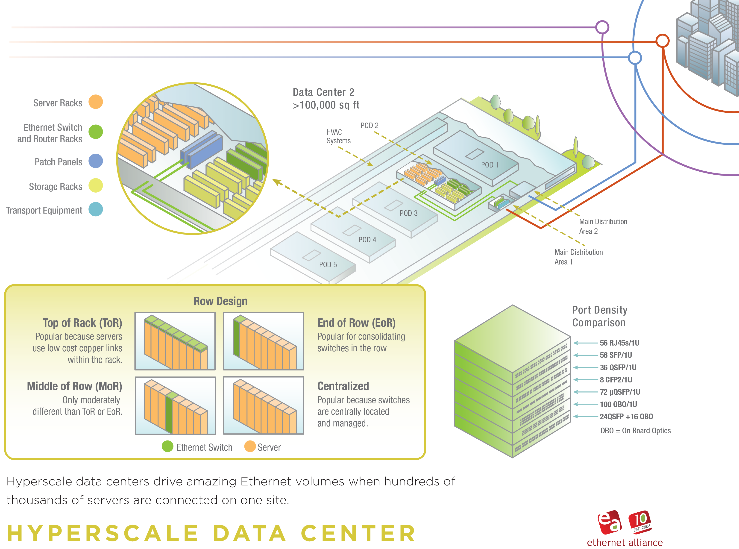
Hyperscale Data Center
3

Slide 4
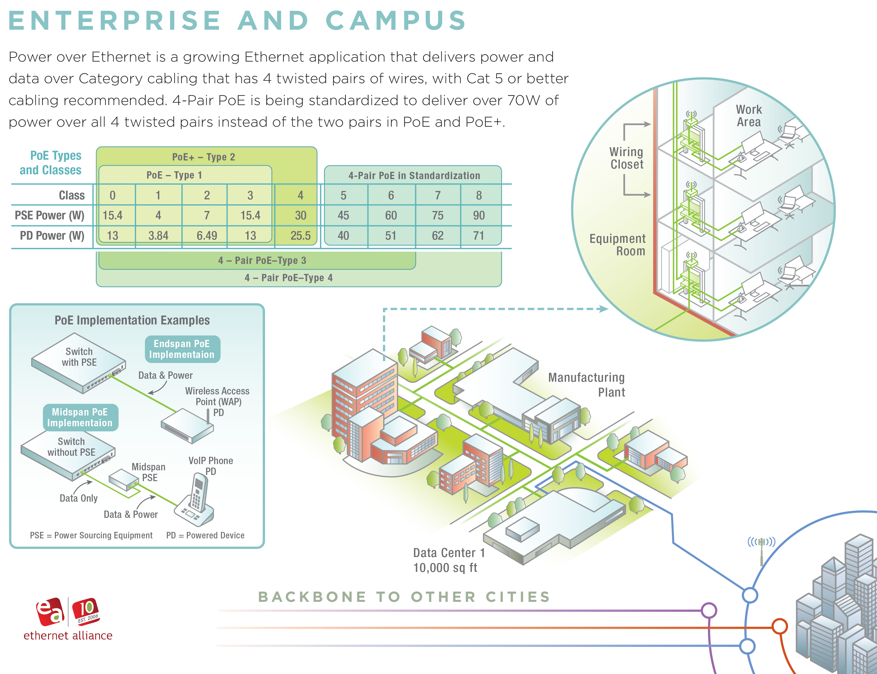
Campus Quadrant
4

Slide 5
Residential Quadrant
5

Slide 6
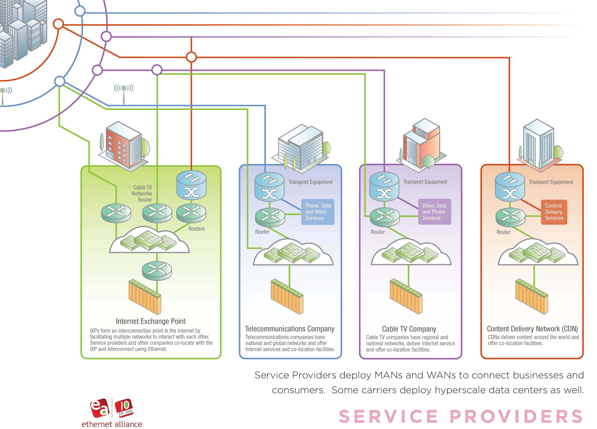
Service Provider Quadrant
6

Slide 7
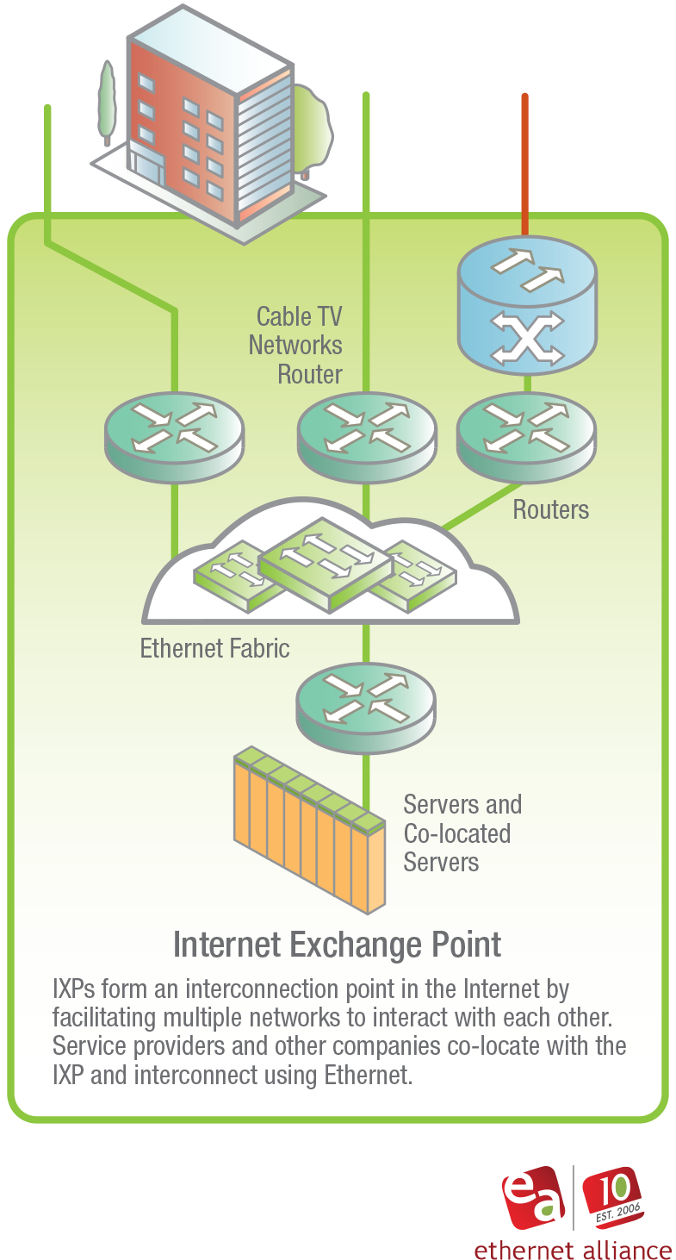
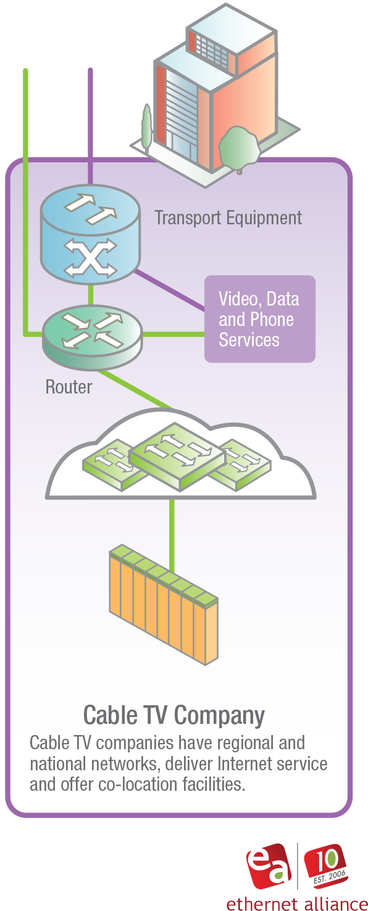
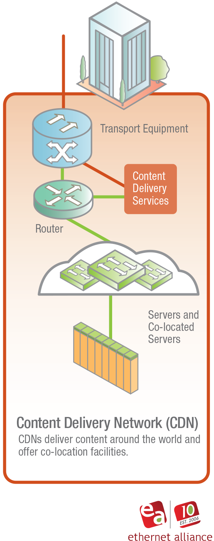
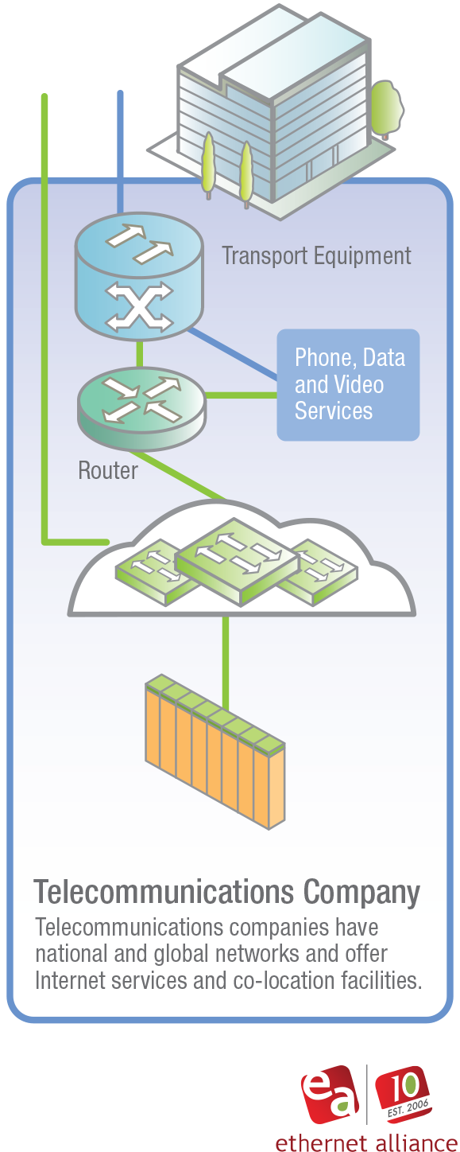
Service Provider Graphics
7

Slide 8
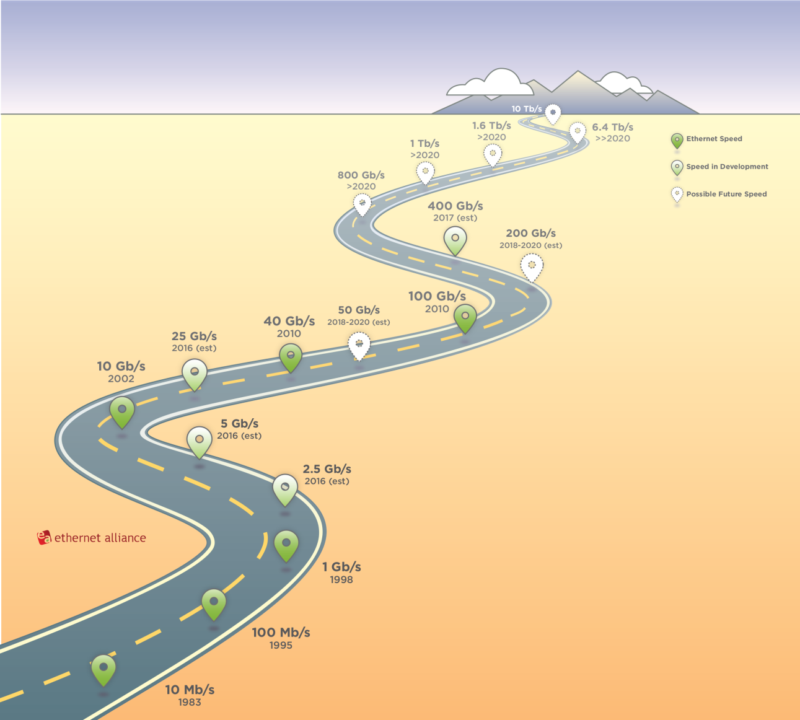
Graphic of Road
The text on these roads have been darkened for better display from projectors

Slide 9
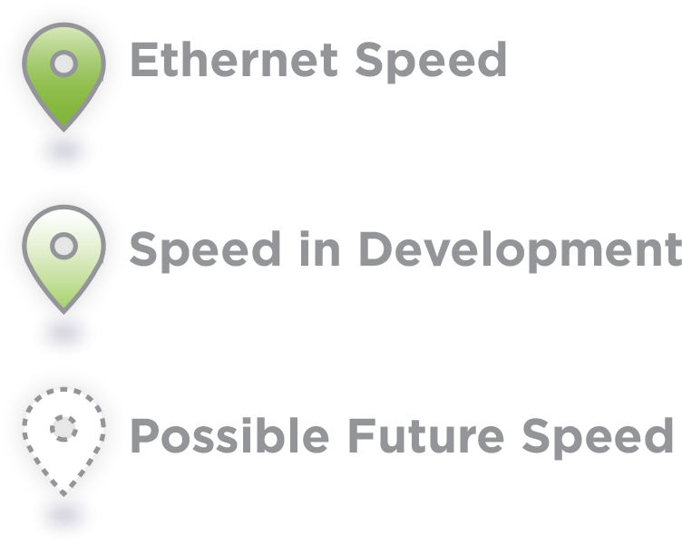
Graphic of Road
These markers can be animated if you want to tell a story

Slide 10
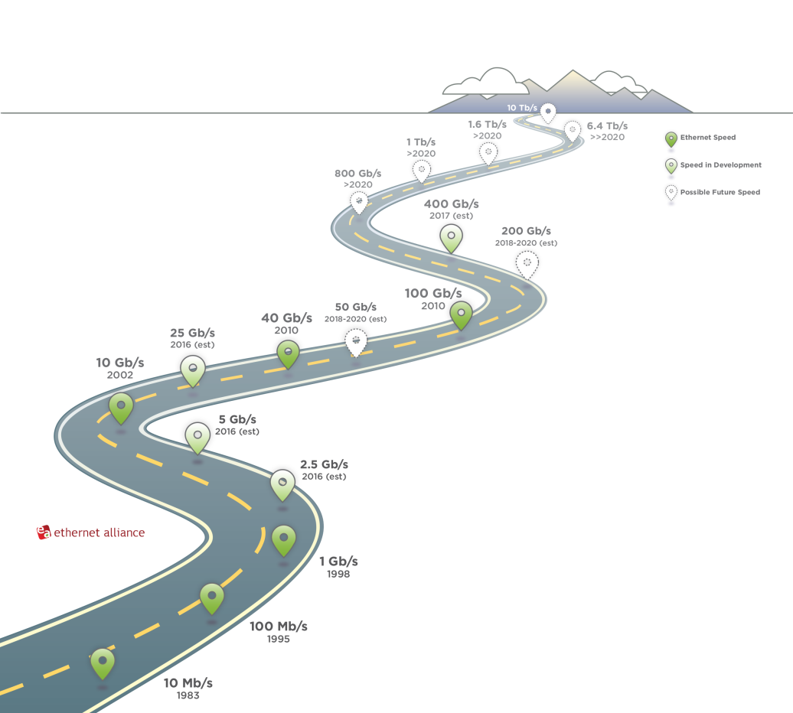

Slide 11
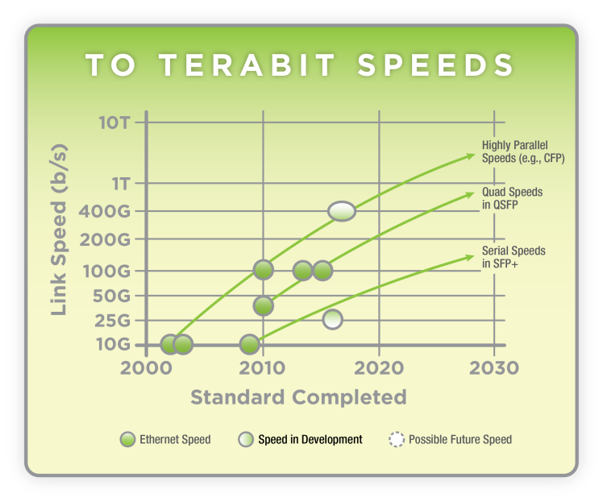
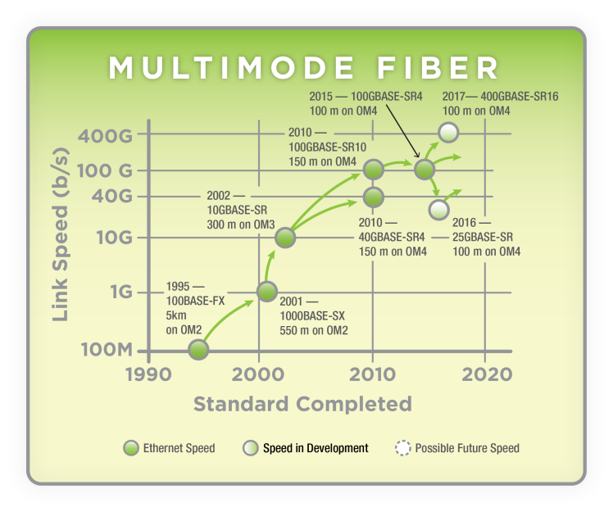
Future Speeds for Animation
You can animate these speed bubbles create some interesting presentations

Slide 12
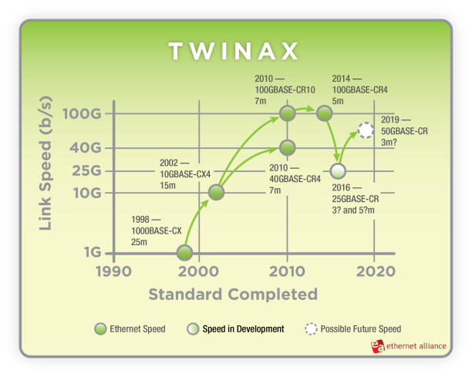
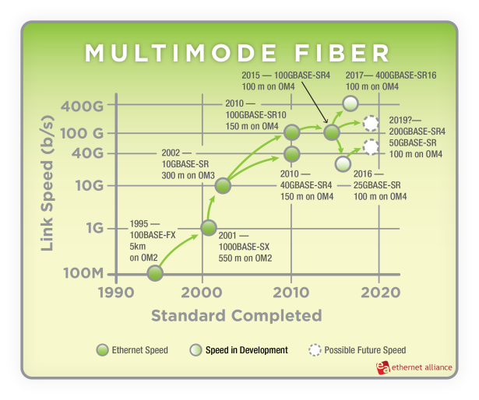
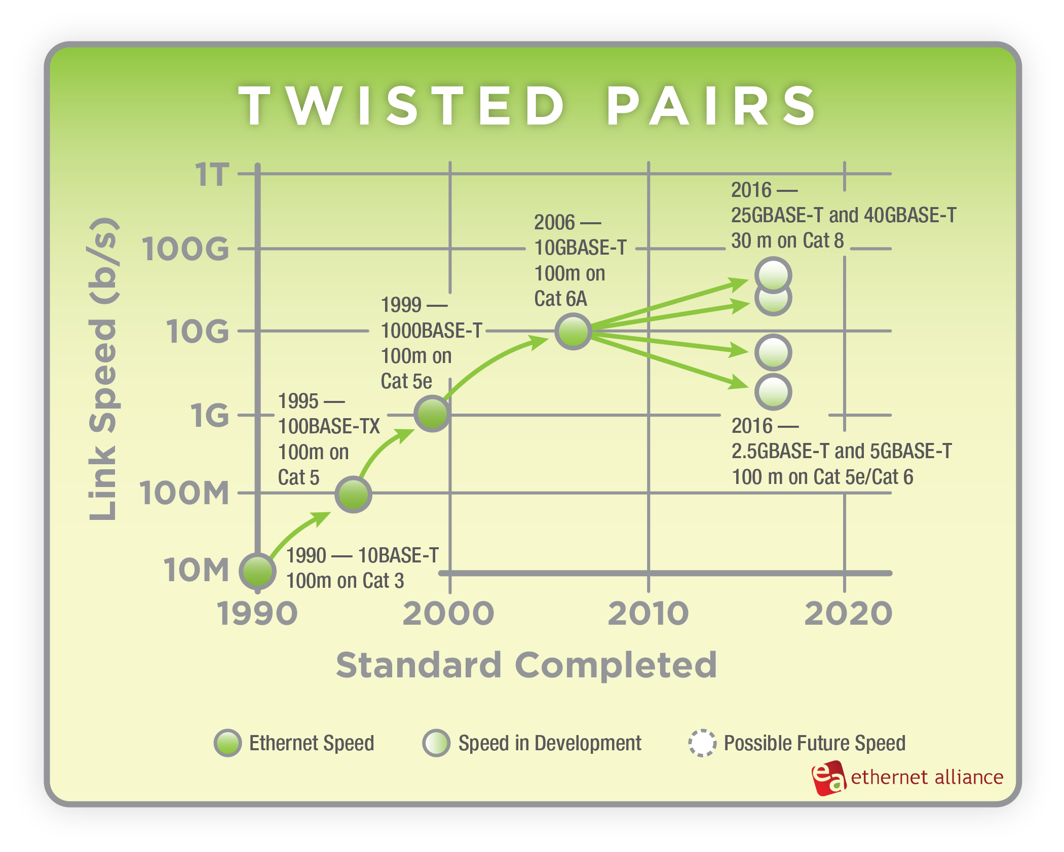
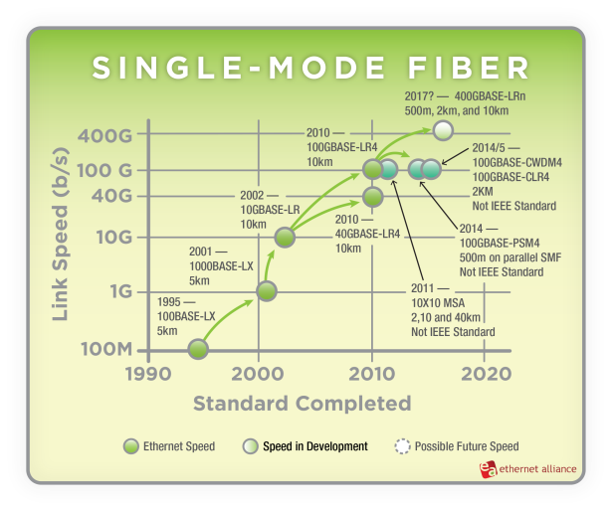
Graphs with Bottom Legend
12

Slide 13
Thank You!

