Slide 1
Roadmap Graphics
– Set (1 of 2)
Scott Kipp
March 8, 2016

Slide 2
Roadmap Graphics
With the release of the 2016 Ethernet Roadmap, we developed many graphics that we would like for people to use
Our website can only support up to 8MB files, so we have broken the file into two presentations
Feel free to use any of these graphics to help explain Ethernet
Most of the graphics are see-through and you can make them opaque by making the shape fill white or any other color

Slide 3
Front of Map

Slide 4
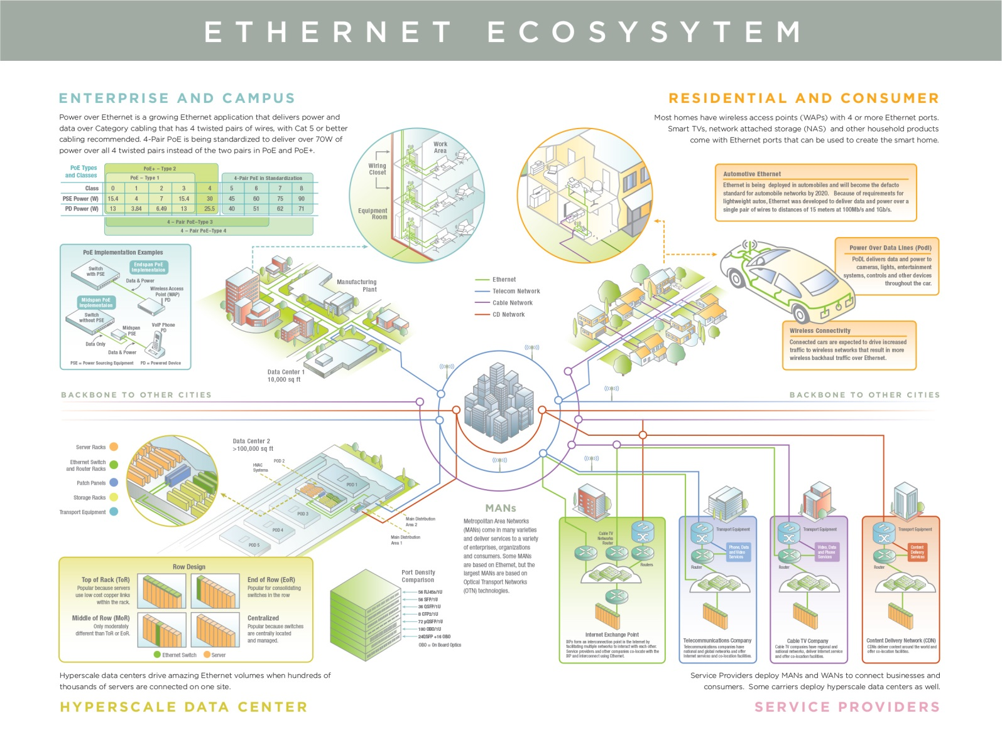
Back of Map

Slide 5
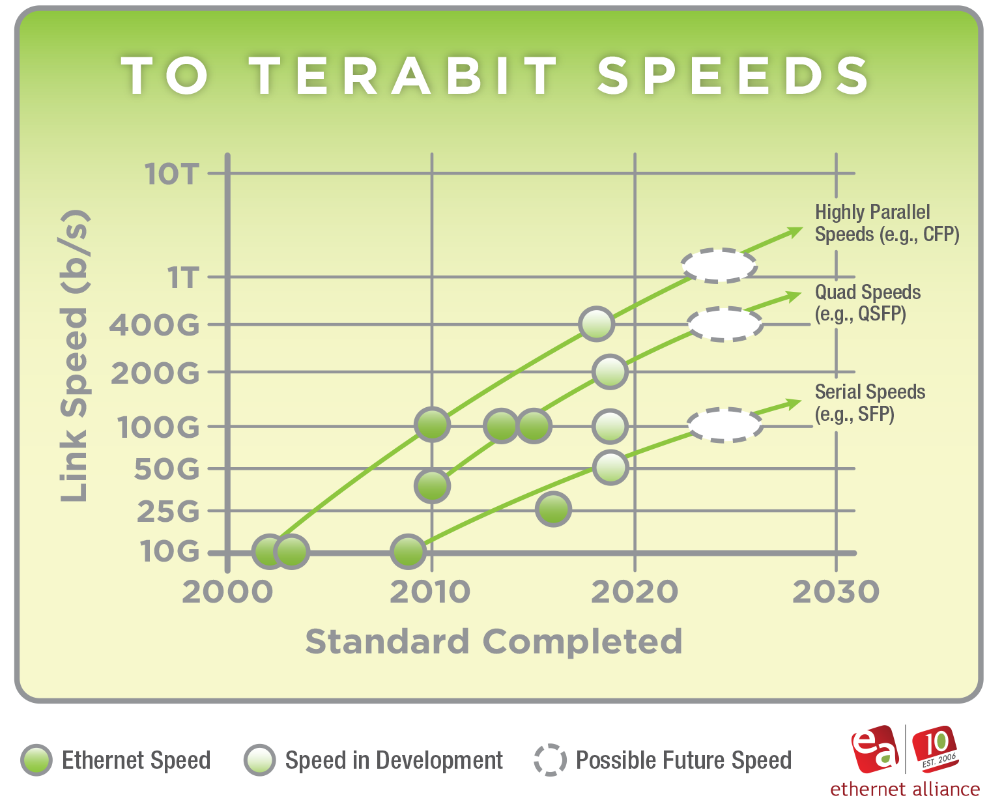
Speeds

Slide 6
Nomenclature

Slide 7
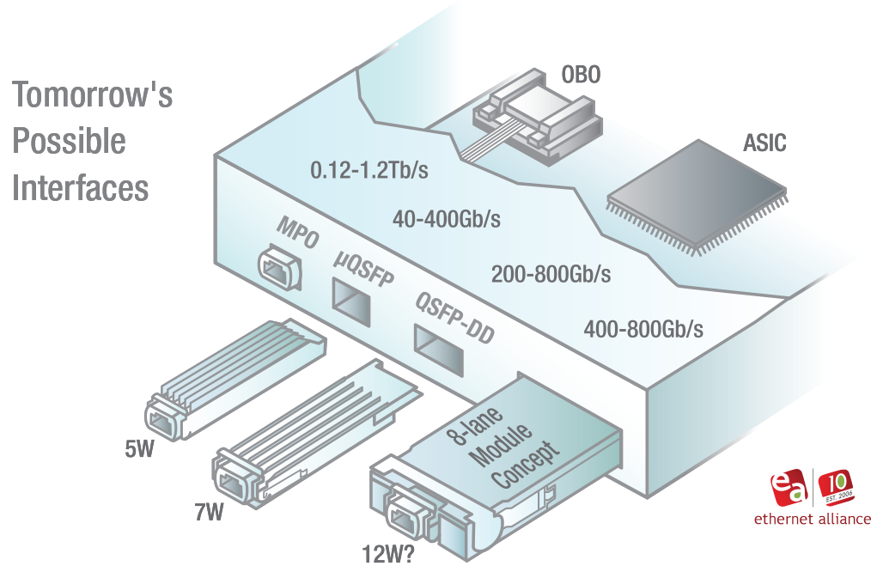
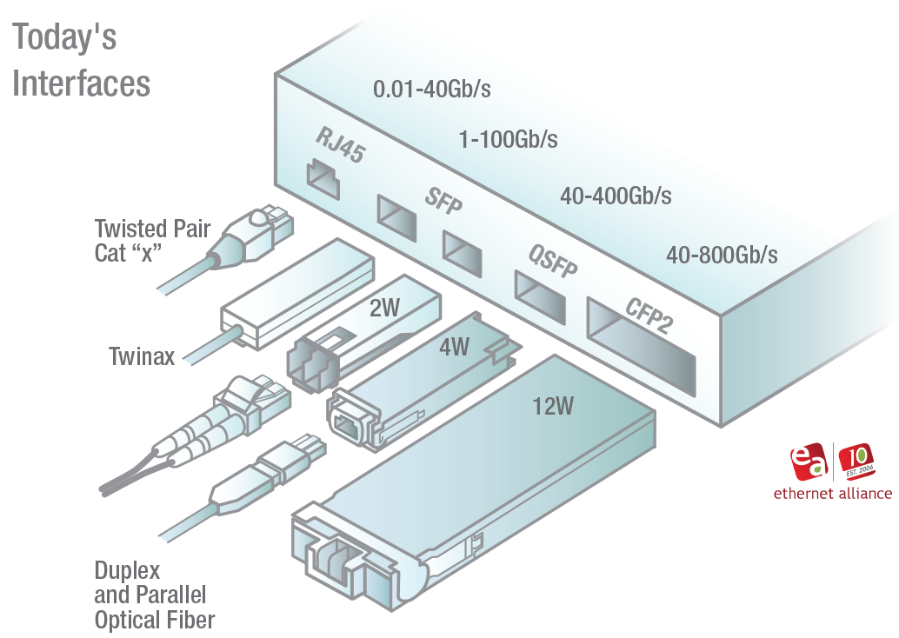
Modules
7

Slide 8
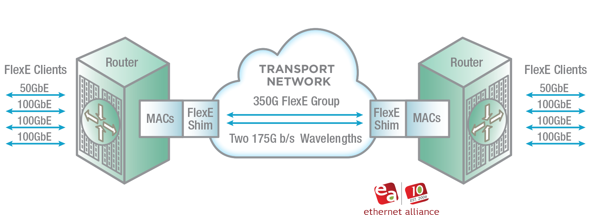
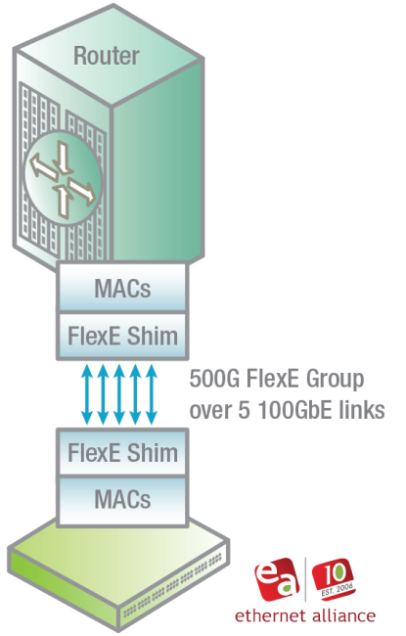
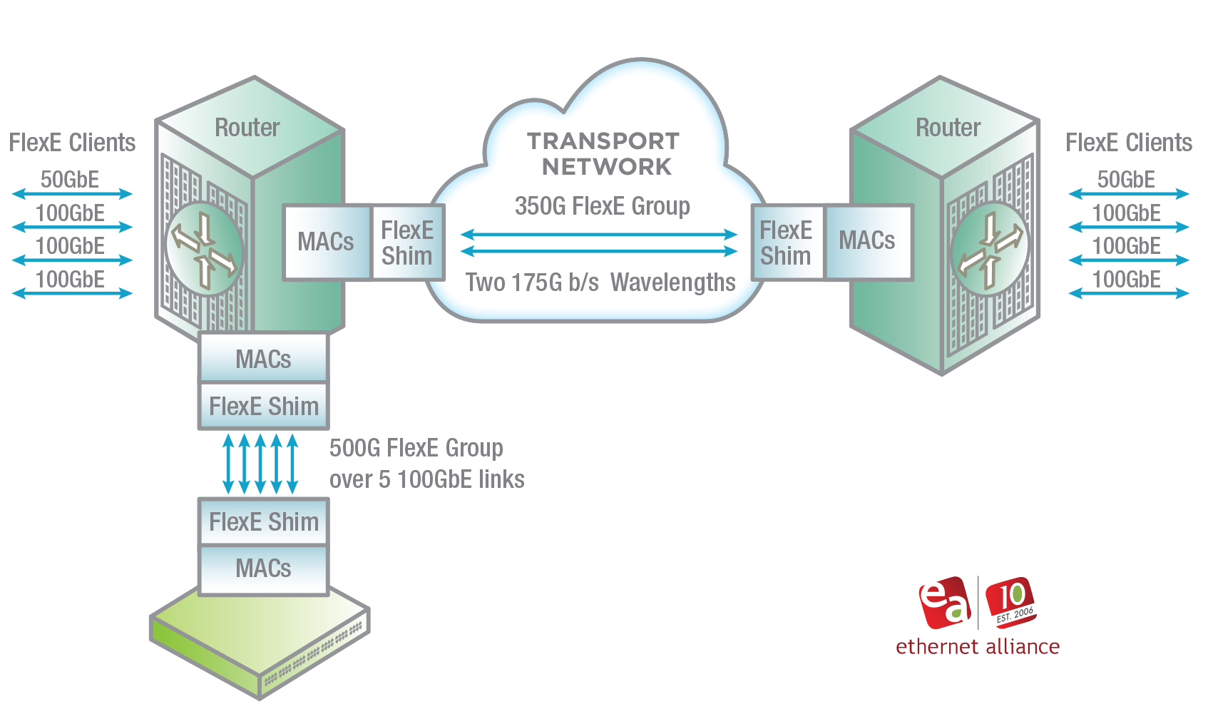
FlexE

Slide 9
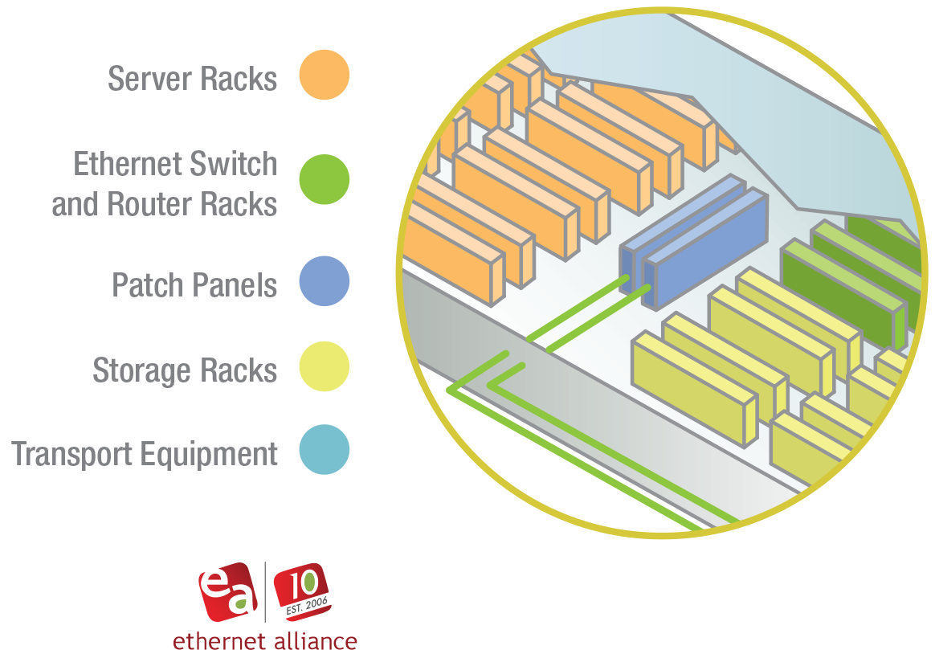
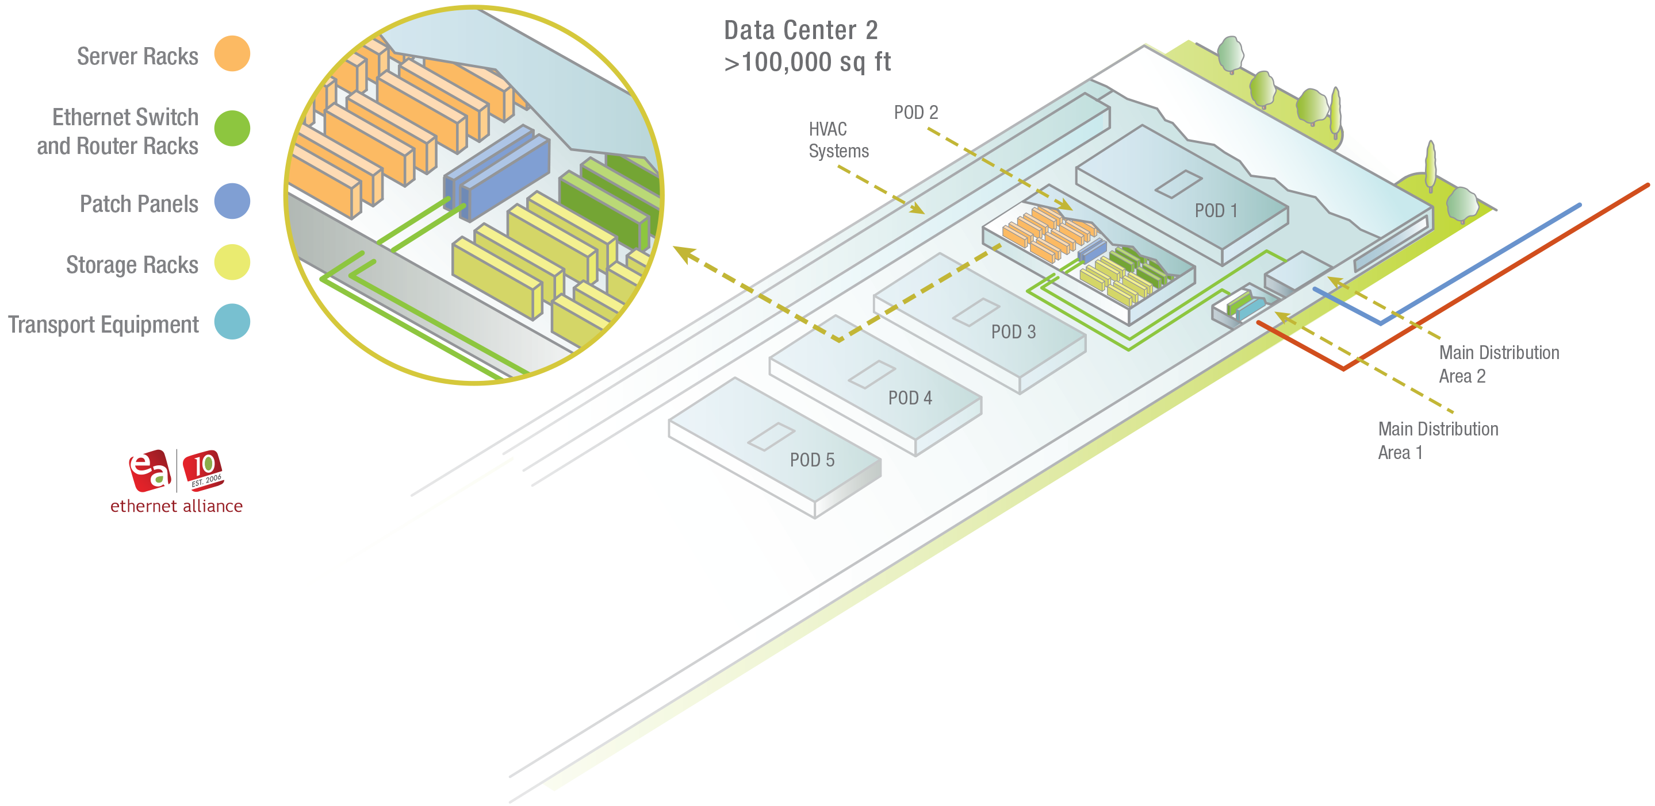
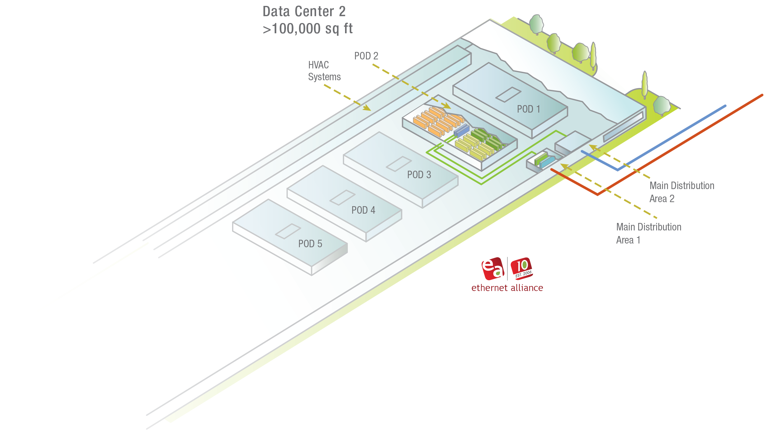
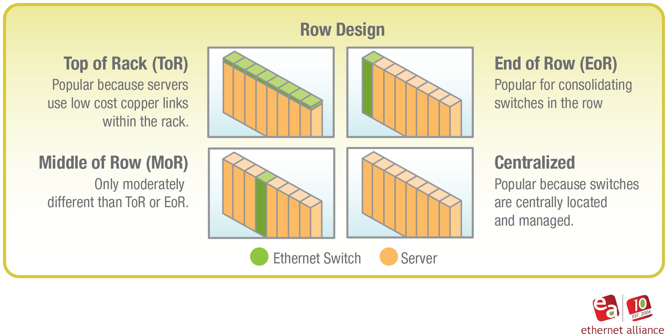
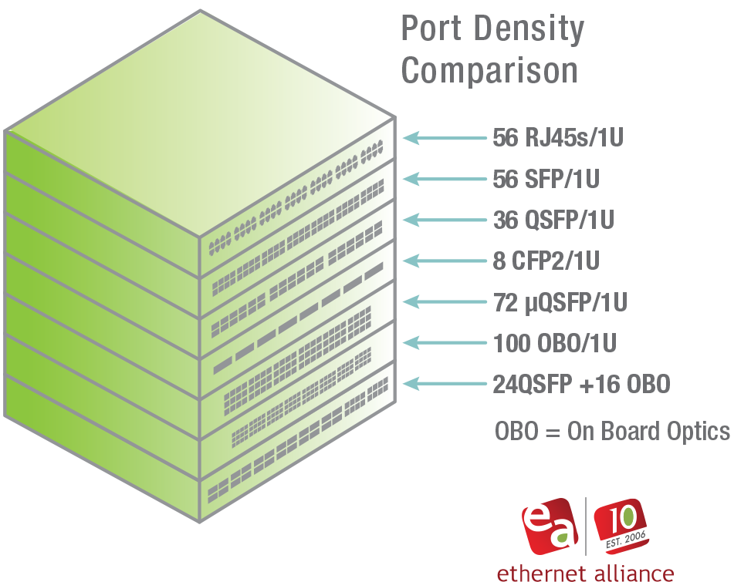
Hyperscale Quadrant Graphics
9

Slide 10
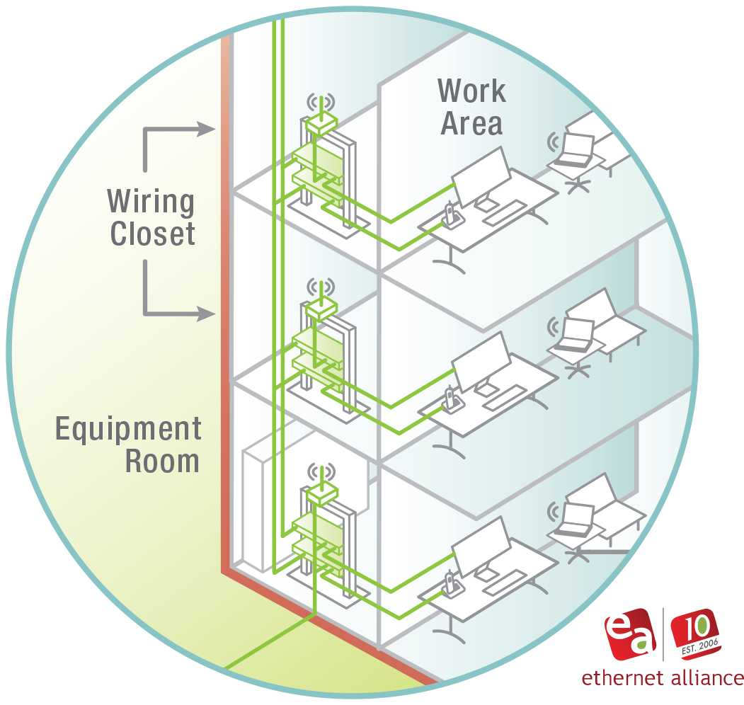
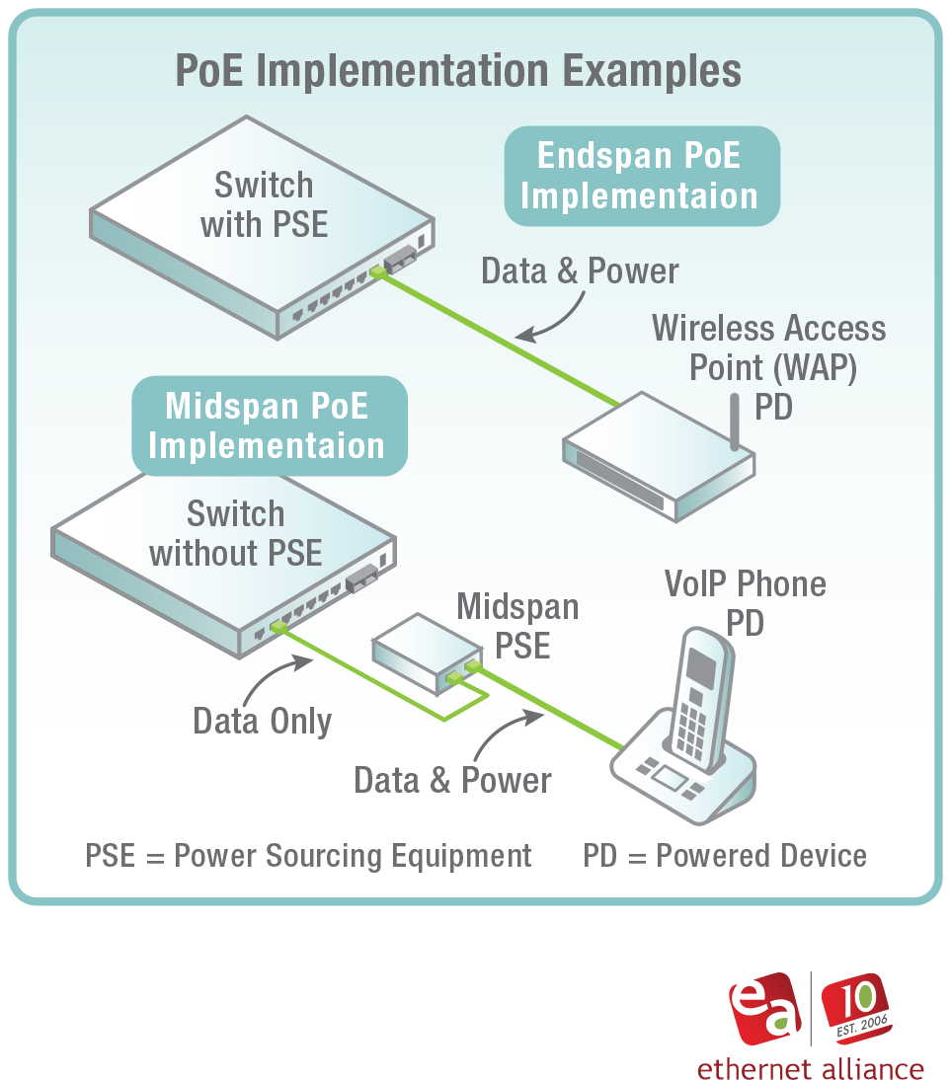
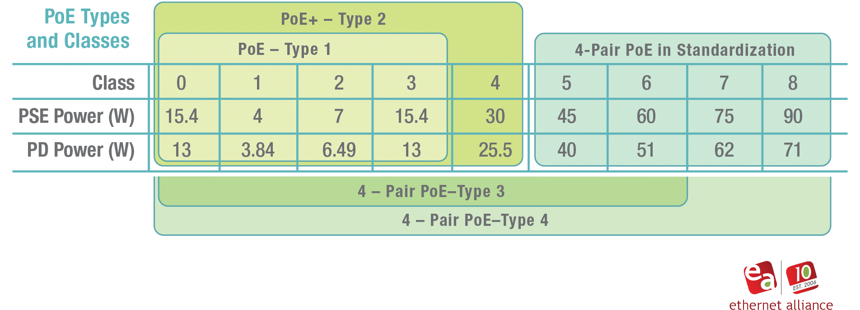
Campus Graphics
10

Slide 11
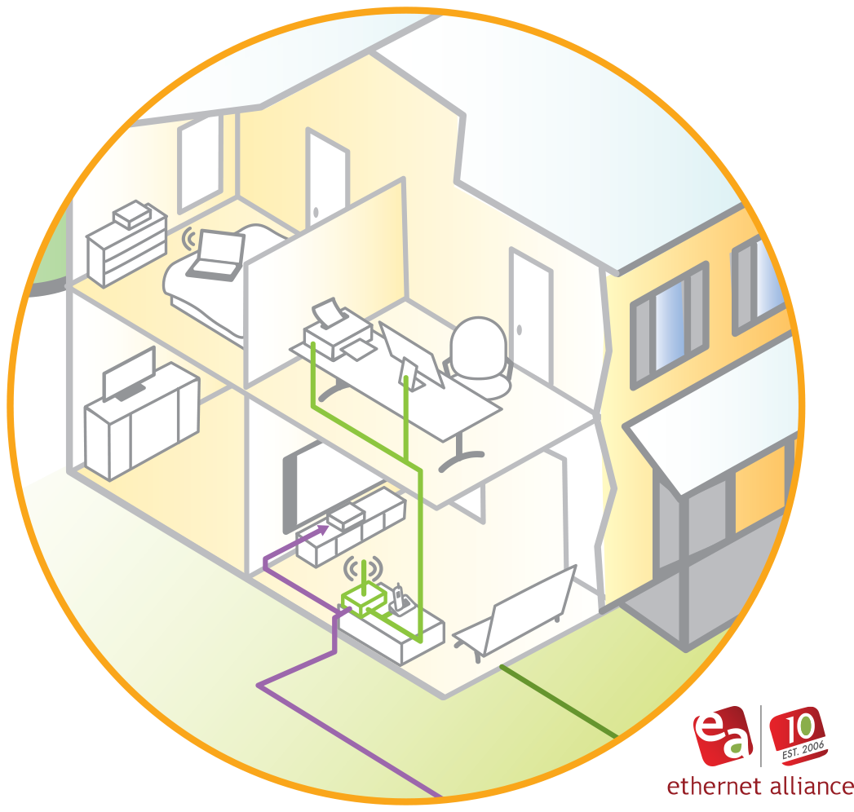
Residential Graphics
11

Slide 12
Thank You!

